Slide 1
Predicting Defaults on Lending Club Borrowers
Greg Morneault
October 6, 2013

Slide 2
What is Lending Club?
World’s largest peer-to-peer lending platform – over $5 billion in loans since 2007
Borrowers obtain a loan and investors purchase notes backed by payments made on loans
All loans are unsecured personal loans < $35K with rates between 6% and 26% based on grade assigned
Investors earn money on interest. Lending Club earns money on origination and service fees

Slide 3
Problem and Hypothesis
Lending Club publishes dataset of all funded loans
Lending Club’s grading algorithm is proprietary and not necessarily transparent
Is there an opportunity to develop a credit risk pricing model that can compete with and more accurately predict default?

Slide 4
Data
Over 350K loans from 2007 to present
Paid off: 14K
Defaulted or Charged Off: 63K
Includes information on funded loan and borrower characteristics and risk metrics

Slide 5
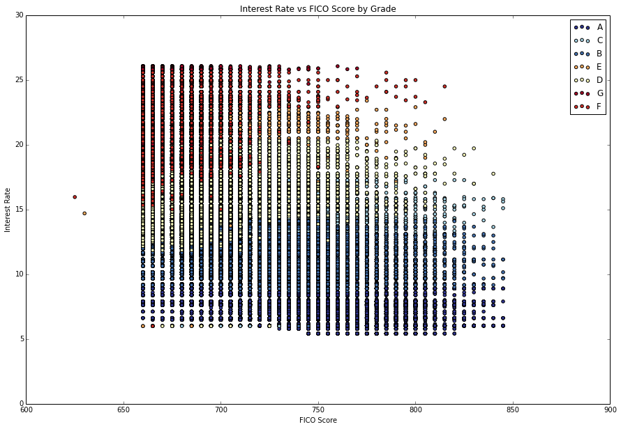

Slide 6
Feature Selection
Loan Details – Issue Date, Amount, Maturity, Purpose, Grade
Borrower Characteristics – Employment, Income, Housing Status, Location
Borrower Credit Metrics – FICO Score, Debt-to-Income Ratio, Credit History and Public Records
Performance – Current Status, Payment History

Slide 7
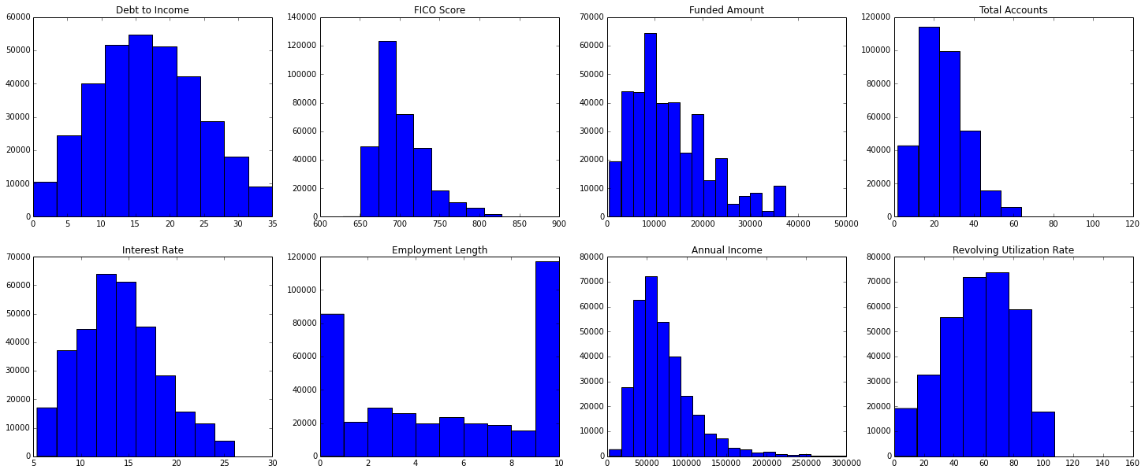

Slide 8
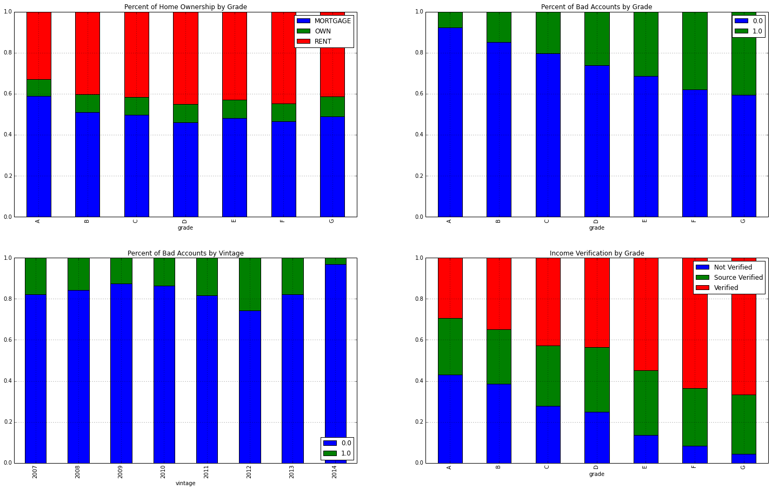

Slide 9
Cleaning and Feature Extraction
Created categorical “Is_Bad” variable:
Bad – Defalted or Charged Off
Good – Paid down or Prepaid
Removed all loans still outstanding from the dataset
Encoded categorical variables: Loan Purpose, Home Ownership, Income Verification, and Grade
Used sklearn Count Vectorizer on Loan Description field for Naïve Bayes classifier

Slide 10
Ranking Feature Importance using Ensemble Techniques

Slide 11
Random Forest
AUC of ROC = 0.651

Slide 12
Logistic Regression
AUC of ROC = 0.658

Slide 13
Naïve Bayes
AUC of ROC = 0.658

Slide 14
Conclusions
Feature Importance – Annual Income, Debt-to-Income, and Utilization Rate are important. Home Ownership and Income Verification add little predictive value.
Very low recall rate for Bad Loans
LOTS of room for improvement but future potential is very high

Slide 15
Next Steps
Spend more time transforming categorical variables – use more dummy indicator variables over numerical encoding
Incorporate macroeconomic data and assign to borrowers location
Pull in data from other peer-to-peer lending marketplaces (e.g. Prosper)

